Slide 1
Workshop 08 QGIS plugin with Python QT

Slide 2
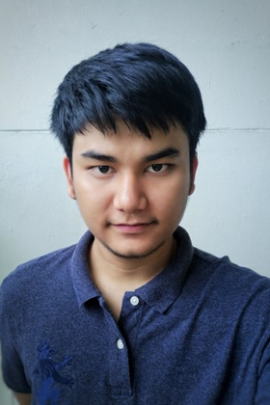
Hello!
I am Anon Bianglae (Non)
Position : Gis Backend Developer
i-bitz company limited

Slide 3
Process is easy
first
second
third
last
Create Plugin
Design Plugin (UI)
Design Workflow (UX)
QGIS Plugin

Slide 4




Use program
QT designer
Python Code Editors
QGIS version 3.xx
QGIS Plugin Builder,
Plugin reloader

Slide 5
Working Process
TMD API
Convert JSON to CSV File
Import CSV File to Point
Interpolation (IDW)

Slide 6
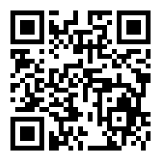
Let's Do It
https://github.com/Anon-B/QGIS-plugin

Slide 7
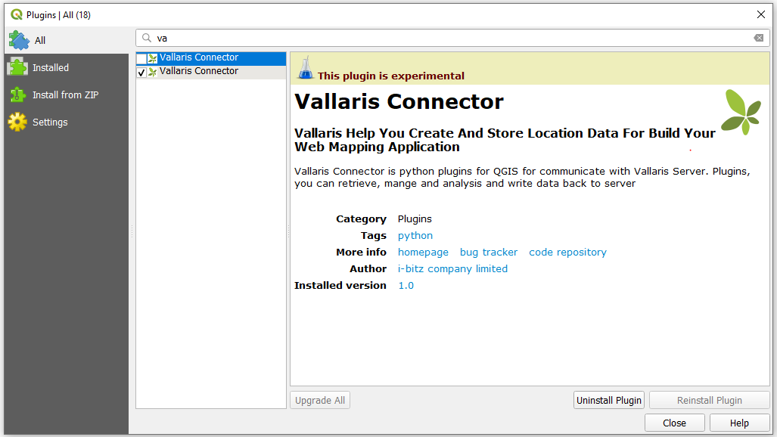
https://vallaris.space

Slide 8
Thanks!
Any questions?
You can find me at
Email : anon.b@i-bitz.co.th
Facebook : https://web.facebook.com/anon.nato

